Slide 1
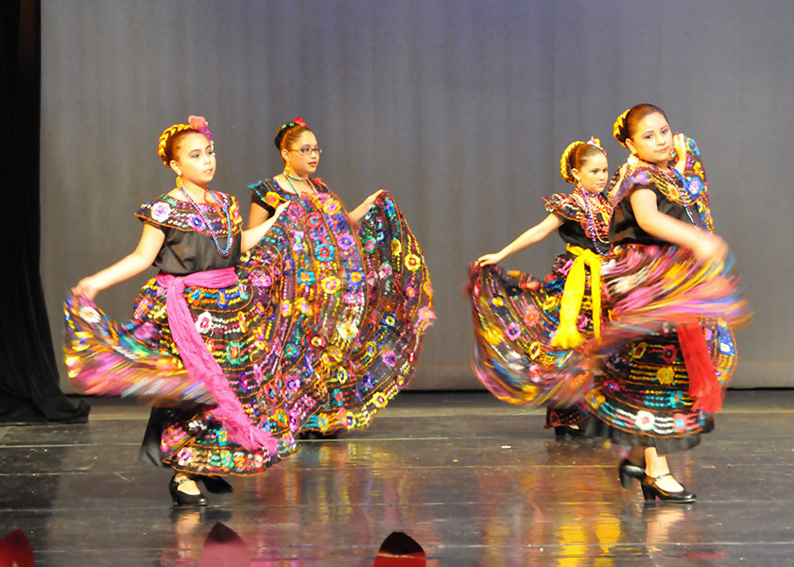
2023 Arts Grant Program

Slide 2
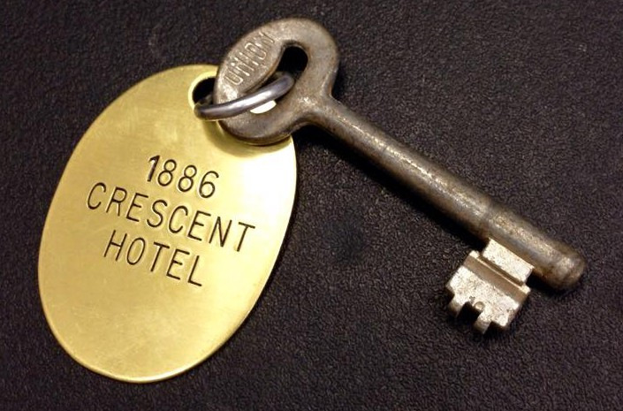
Hotel Occupancy Tax funds
Texas Tax Code Section 351
Per state law, HOT revenue may be used only to
promote tourism AND the convention and hotel industry.
Permitted uses of HOT funds related to arts & cultural activity:
“The encouragement, promotion, and application of the arts….
related to the presentation, performance, execution, and exhibition
of these major art forms.”
The tax code outlines that any (current, active 501c3) non-profit organizations
that promote art and cultural activities (events and projects), including gastronomy
are eligible to submit to the grant.

Slide 3
FUNDS MAY BE USED FOR:
Marketing and promotion
Artist related costs
Payments to artist
Production or exhibition related costs
Direct costs specific
to the project

Slide 4
FUNDS MAY NOT BE USED FOR:
General operating costs such as salaries or overhead
Staff travel, conferences or membership dues
Food or alcoholic beverages
Fundraising events
Receptions, social functions
or parties
Projects already funded or completed
Fireworks
Grant preparation costs
Scholarships, awards or cash prizes

Slide 5
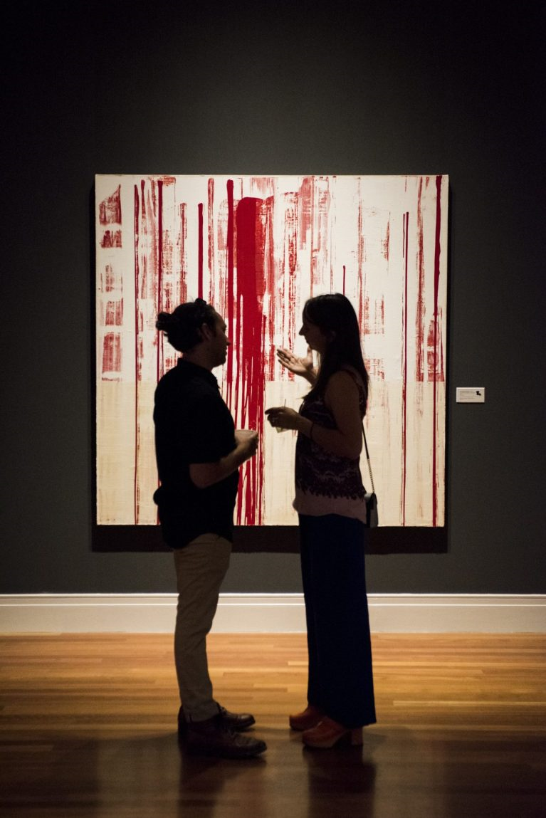
‘Project’:
A singular event or series of
related activities or events.
Maximum award:
50% match up to $15,000
Grant Cycle:
Jan 1 – Dec 31, 2023

Slide 6
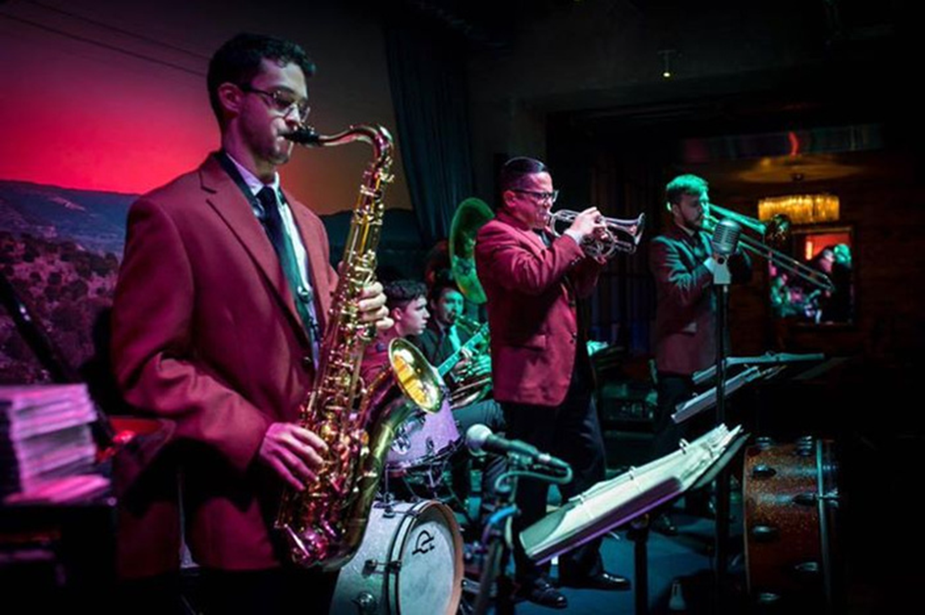
Basic Eligibility Requirements
Meet the application deadline
Provide proof of IRS 501c3 designation as a public charity no later than August 1, 2021
Provide proof of registration with the Texas Secretary of State to transact business in Texas
Provide copy of the first page of 2019 IRS Form 990
Be physically based and offer events primarily in the City of Corpus Christi
Be governed by a local BOD that meets quarterly
Not have any outstanding legal or financial items with the City of Corpus Christi
Show a dollar-for-dollar match from cash revenue other than city funds revenue collected during grant year

Slide 7
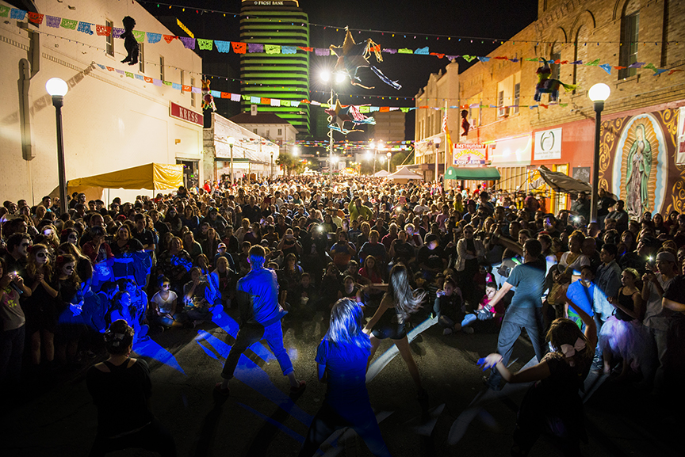
The Evaluation Process
Reviewed by
1. ACC City Staff Liaison for missing or incomplete documents,
2. City Legal Staff for valid documentation
3. City Finance Staff for outstanding balances on the part of the organization to
the City of Corpus Christi.
Eligible applications are then reviewed, scored, and discussed by the Corpus Christi Arts and Culture Commission (ACC).
The ACC advises the Corpus Christi City Council on grantee funding.
Council makes the final decisions on all applications.

Slide 8
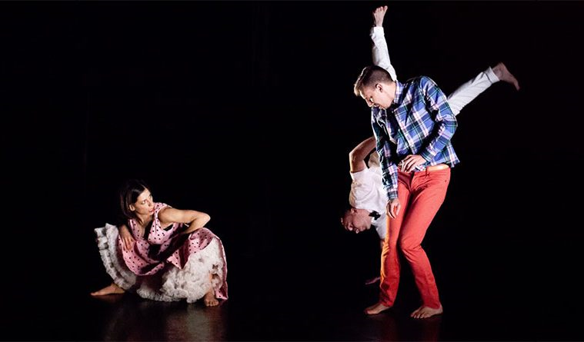
Artistic Merit: 40 points (possible 10 points each)
This question set allows the applicant to present their organization as a significant part of the cultural fabric of Corpus Christi. We suggest grant authors:
Use facts and numbers
List or bullet point to summarize qualifications
Avoid repetition, flowery language, and lofty tones. No opinions, just facts.
1. Describe how the organizations past programs or
services demonstrated cultural significance for the
community.
2. Describe the unique characteristics and artistic vision
of this proposed project.
3. List the qualifications of the proposed participating
artists or experts and identify their role in the project.
4. In what ways will the project support the ACC’s mission.

Slide 9
Economic and Social Impact: 60 points
(possible 10 points each)
This question set qualifies the application and quantifies its
strength. We suggest authors use statistical information to support their arguments.
1. Detail how the project will attract visitors to Corpus
Christi from 125 miles and what the expected attendance is.
2. Describe your marketing plan to attract overnight
visitors?
3. List the methods that will be used to collect data
regarding audience demographics, audience
involvement, and tourists in attendance.
4. Describe the growth of your event from years past (include solid statistics if you have them).
How do you see your event growing or changing in the next 5 years?
5. List all the sources of revenue for the proposed project (this grant included).
6. How will the project stimulate the local business
economy? List local businesses and organizations you will be working with.

Slide 10
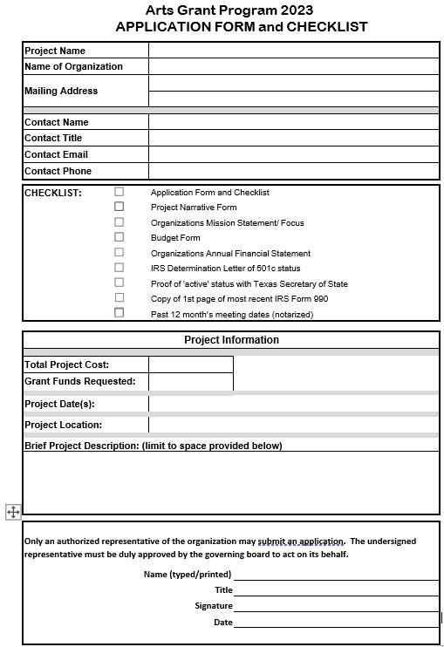
Application Form & Checklist
Project Narrative Form
Budget Form
Proof of 501c3 – copy of IRS determination or affirmation letter (www.irs.gov)
Proof of ‘active’ status by Texas Sec of State
Copy of first page of IRS Form 990 for FY2021
Notarized sworn statement of meeting dates for the past 12 months, list of Current Board of Director’s, and the Chair’s contact information.

Slide 11
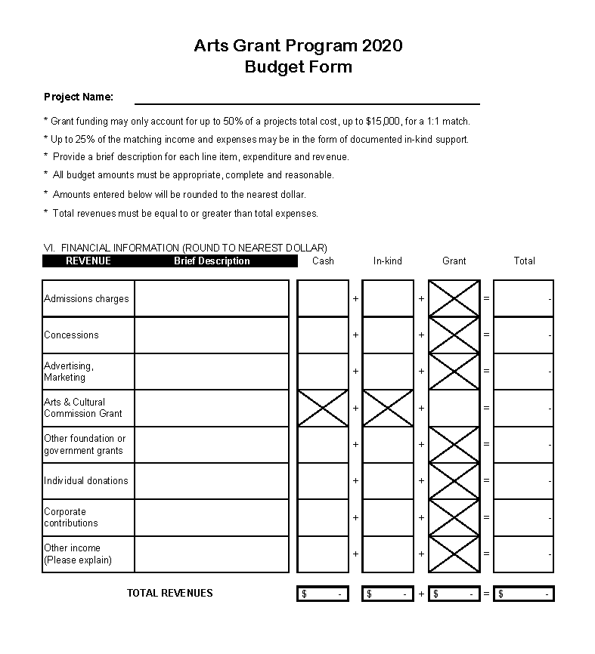
This form reports anticipated revenue. Actuals will be reported in your completion report submitted after your event.
Place the amount of your anticipated grant award in this box.

Slide 12
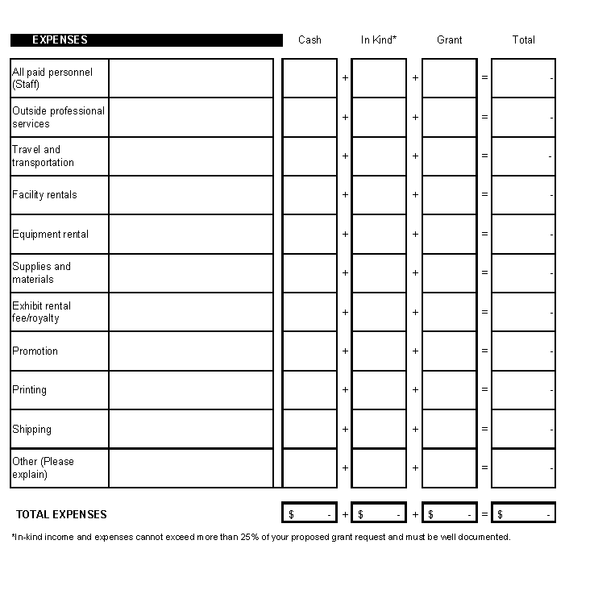
In-kind totals can be up to 25% of the grant request. See In Kind slide for more information.

Slide 13
Budget Notes
Total Revenue must be equal to or greater than total expenses
50% match of project’s total cost up to $15,000
In-kind up to 25% of grant request
In-kind Expenses = In-kind Revenue

Slide 14
In-Kind
Follow generally accepted accounting principles (GAAP), established by the Financial Accounting Standards Board (FASB), which state:
Contributions of services shall be recognized if the services received:
• create or enhance nonfinancial assets; or
• require specialized skills, are provided by individuals possessing those skills, and would typically need to be purchased if not provided by donation. Services requiring specialized skills are provided by accountants, architects, carpenters, doctors, electricians, lawyers, nurses, plumbers, teachers, and other professionals and craftsmen.

Slide 15
Grantees are required to:
Acknowledge grant support on all promotional materials using the ACC HOT logo. There are several versions. Here are a few:

Slide 17
Payment and Reporting
GRANT PAYMENT:
2 installments
1 month after legal agreement has been signed (generally in March)
2 weeks after completion report submitted and accepted

Slide 18
Payment and Reporting
COMPLETION REPORT
due 45 days from the event
provide audience residence survey results
Include promotional and marketing samples
report actual revenue and expenditures
use supporting document summary form to
submit all supporting documentation
give explanations of significant variances
between anticipated and actual revenue and expenses

Slide 19
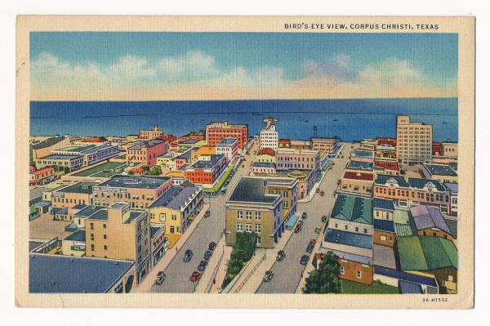
Your event shapes our community.
Know its valuation.
Put a number on it when you talk about it.

Slide 21
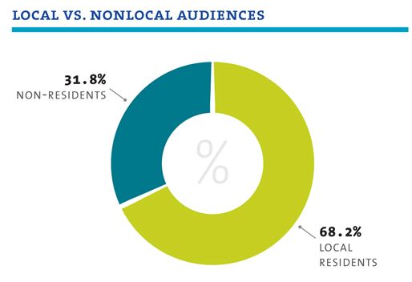

Slide 22
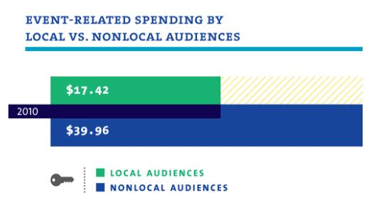

Slide 23
